Slide 1
LOKI: A Desktop-Native Voice Assistant with a Hybrid Natural Language Understanding Engine
Rudra Garg, Rahul Singh, Priyanshu, Pawan Bhatt
Project Supervisor: Dr. Kuntal Dey
CS 683: Natural Language Processing
Indian Institute of Information Technology, Guwahati

Slide 2
The Problem with Today‘s Voice Assistants
The Issue: Most voice assistants today are cloud-based, which creates some key drawbacks when used on a desktop computer.
Privacy Concerns: Your voice data is sent to company servers for processing.
Lag & Latency: There's a noticeable delay as data travels to the cloud and back.
Limited Control: They can't deeply interact with your operating system to manage files or apps.
No Internet, No Assistant: They simply don't work if you're offline.
Our Goal: To build a voice assistant that runs entirely on your machine, solving these problems.

Slide 3
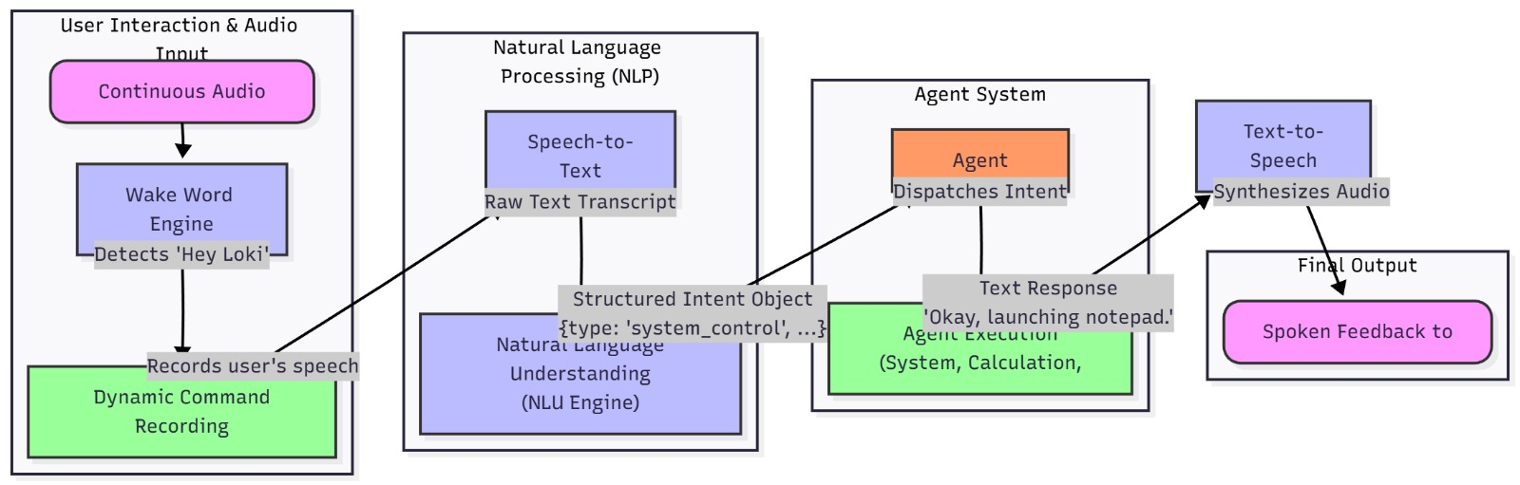
How LOKI Works: A Step-by-Step Look
Ø Firecrawl

Slide 4
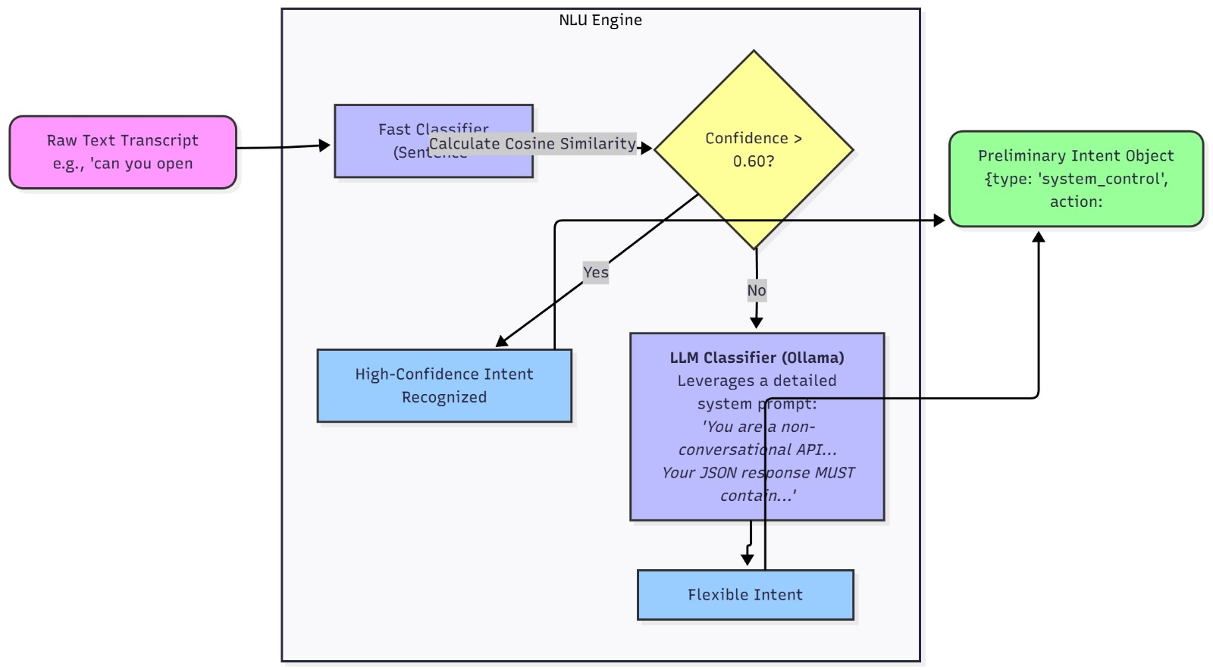
The Brains of LOKI: A Two-Layer Approach
1. Tokenisation
2. Remove Stop Words
Raw Documents
’£'₋
Processed
Data
Modeling
3. Stemming
4. Normalisation

Slide 5
Finding the Details: Named Entity Recognition
The Challenge: Knowing you want to "launch an app" isn't enough. We need to know which
app.
Our Solution: We trained a custom model to specifically find and label these key pieces of information in a sentence.
How it Works: The model looks at more than just the words; it considers:
Word Shape: Is it capitalized like "Notepad‘ or does it contain numbers*
Grammar: Is it a noun or a verb‘?
Context: What are the words next to it‘? (e.g., the word ”launch" is often followed by an app name).

Slide 6
HowWell Does It Work? Performance & Results
NER Model Accuracy
End-to-End Pipeline Tests
Scenario 1 (Simple Command): "Hey Loki, open notepad."
Result: Processed by Fast Path, Notepad launched.
Scenario 2(Complex Command):
"what is the square root of 144 times 9?" Result: NER identified math phrase, correct answer returned.
Scenario 3 (Unknown Command):
"what's the weather like today‘?"
Result. Correctly identified as unknown, gave default response.
Weighted FI-Score of 0.9977 on our test data.
Entity Tag | Precision | Recall | F1-Score | Support
B-APP_NAME | 1.0000 | 0.9962 | 0.9981 | 281
I-APP_NAME | 0.9917 | 1.0000 | 0.9958 | 119
B-MATH_EXPRESSION | 1.0000 | 1.0000 | 1.0000 | 15
I-MATH_EXPRESSION | 1.0000 | 1.0000 | 1.0000 | 37
Weighted Avg | 0.9977 | 0.9977 | 0.9977 | 432

Slide 7
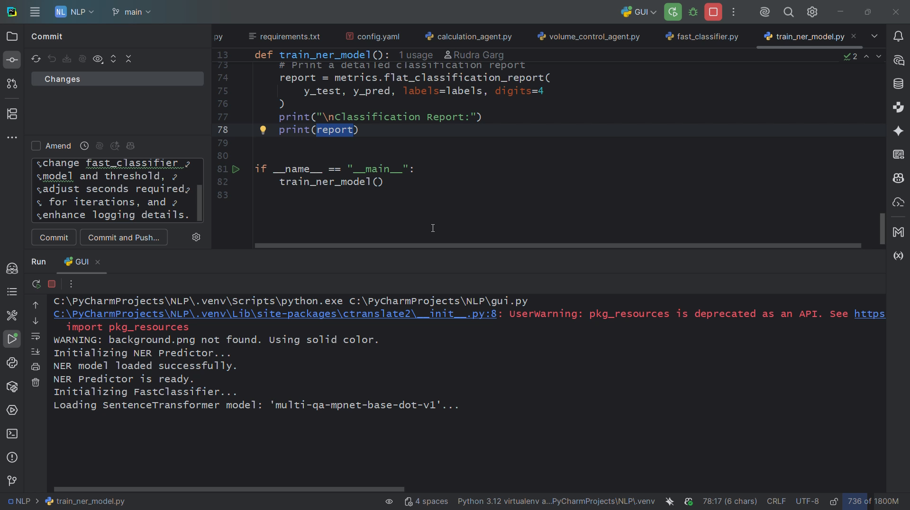
System Demonstration

Slide 8
Thank You

